Slide 1
Understanding and critical media literacy
Mobilitatea:Spania

Slide 2
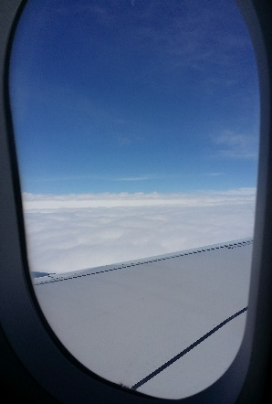
First Day
15
04
2018
In the afternoon we arrived in Spain we was waiting for our host. Soon we went to their home where after a tour of the house we decided to give them the gift, surprising us their joy and enthusiasm at the sight of the Romanesque gift.

Slide 3
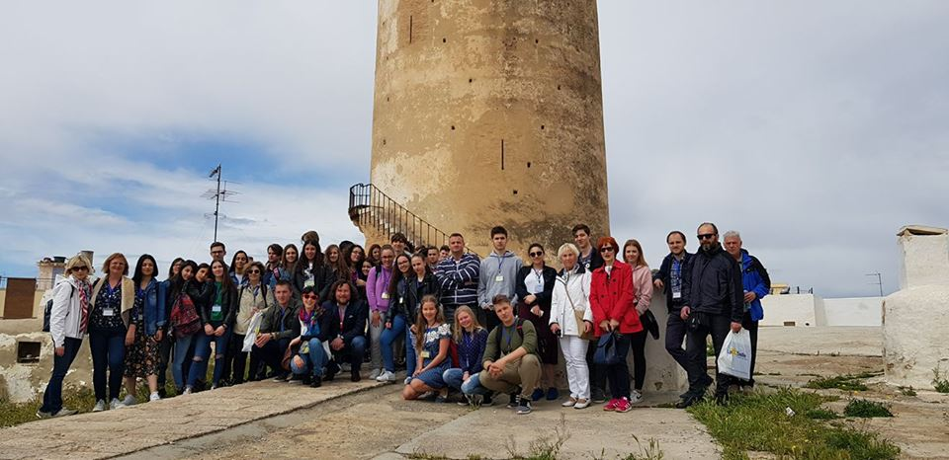
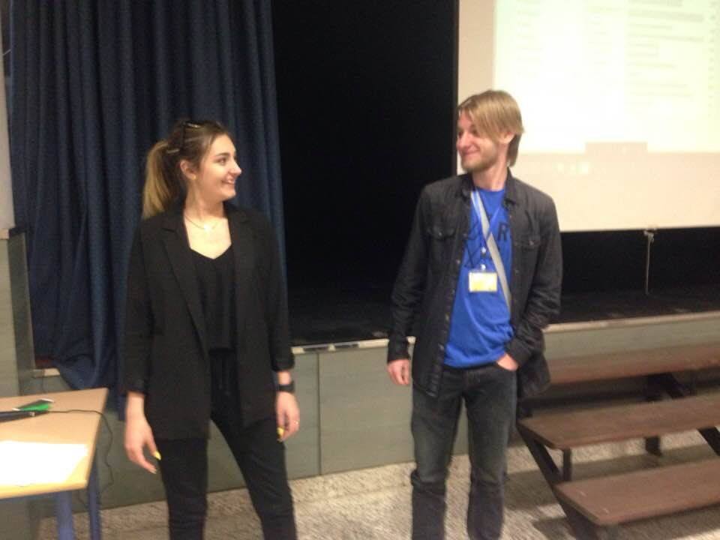
Second day:
16
04
2018
At 8am we got to school, in the amphitheater, where the school principal held a speech, then we saw a video about Valencia, we played a game made by Slovakia, watch Czech Republic lesson plan and I presented our lesson about internet safety My Online Reputation .We also visited Paterna and Paterna's Tower.

Slide 4
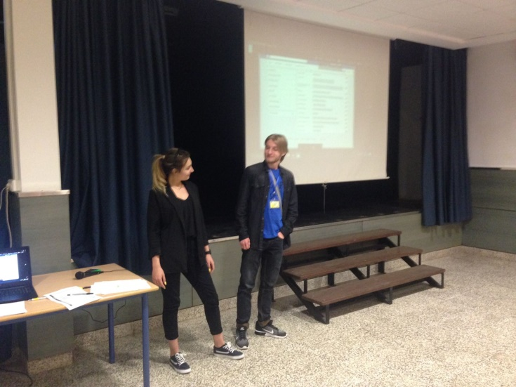
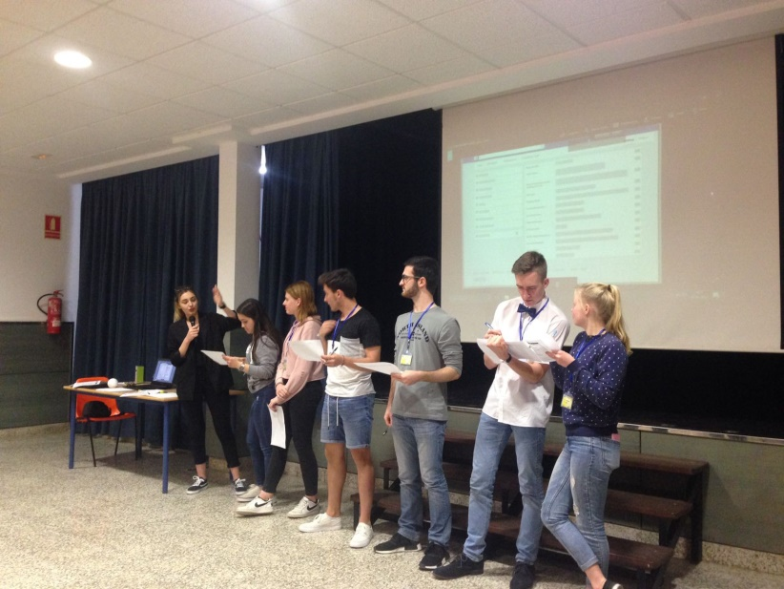

Slide 5
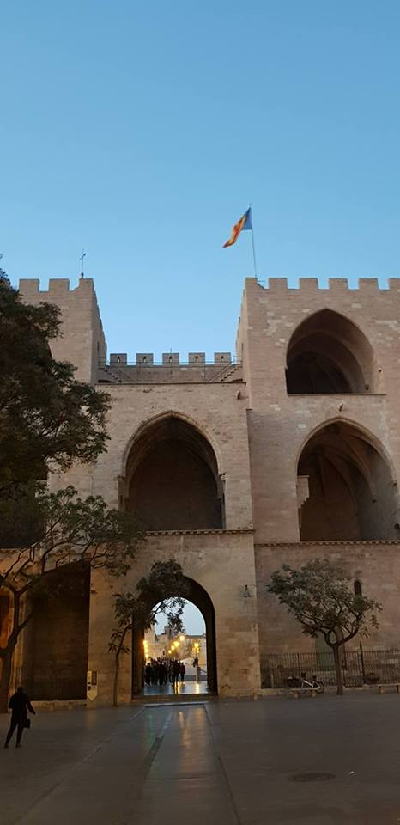
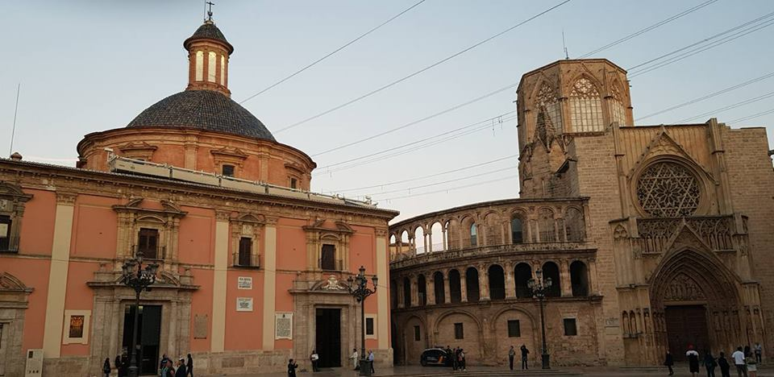
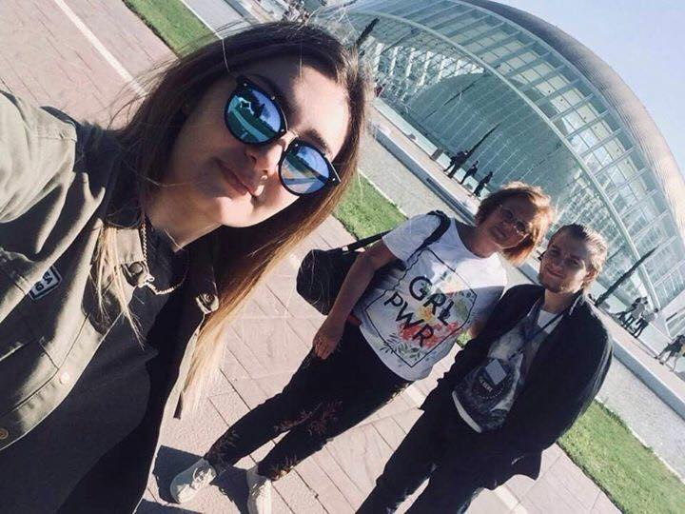
Third day:
17
04
2018
At the school we met with the rest of the groups and the teachers where we played a game made by Spain and went on a trip to Valencia. In Valencia we made a guided tour of the city, we had free time for lunch and then we was at the City of Arts and Science.

Slide 6
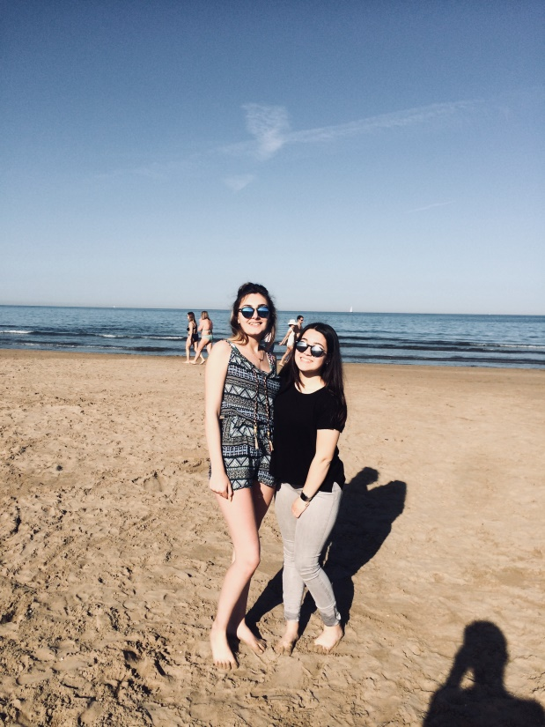
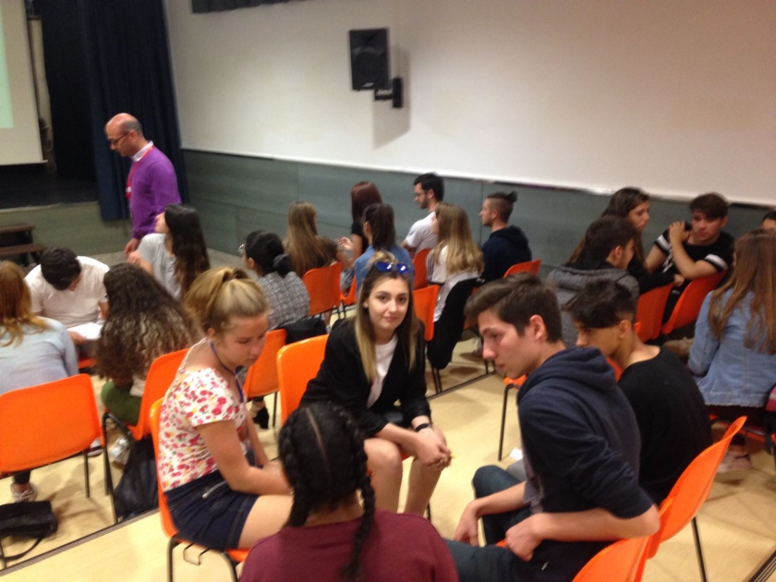

Slide 7
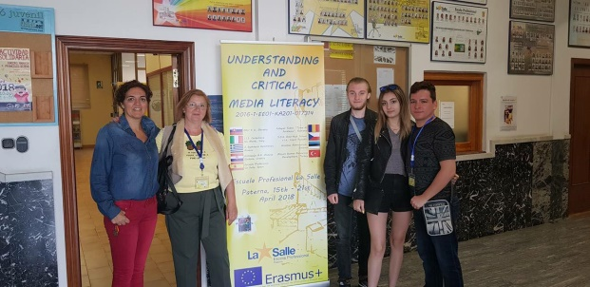
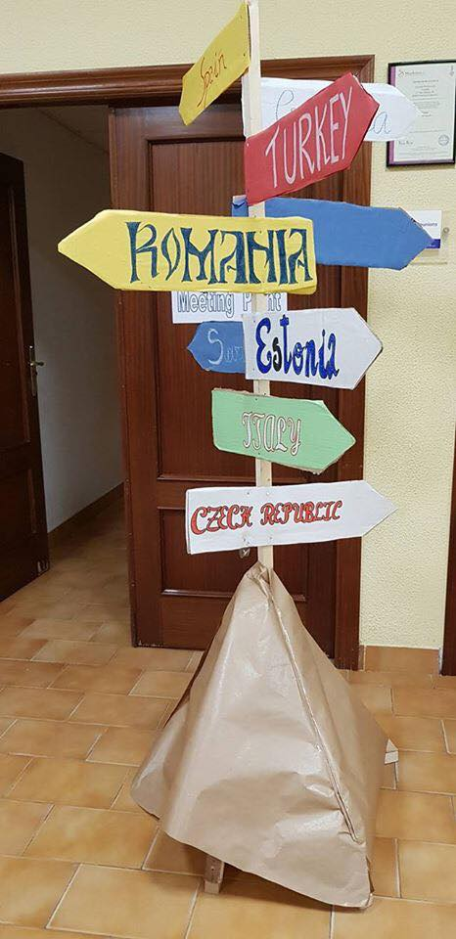
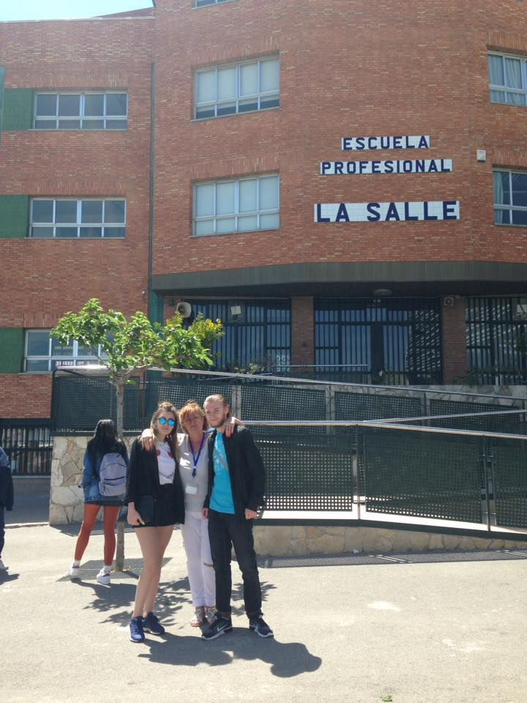
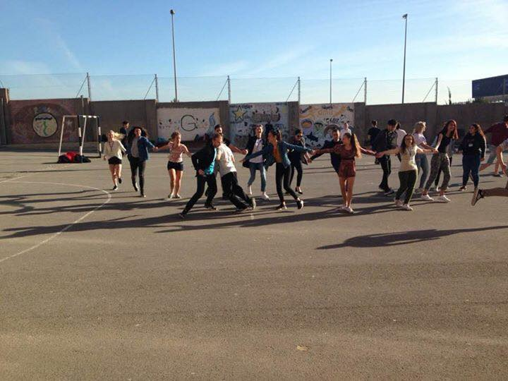
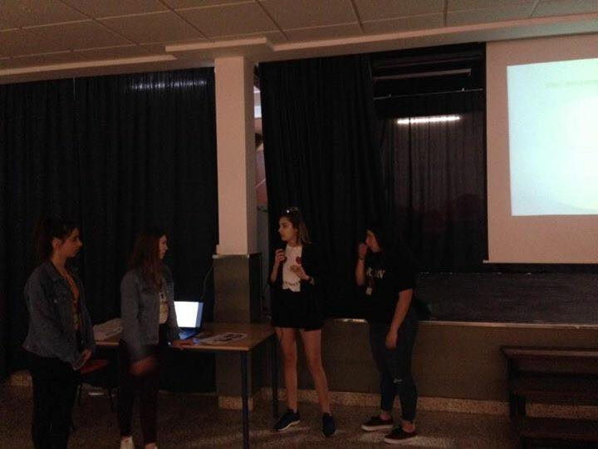
Fourth day:
18
04
2018
That morning we had various game made by Croatia,Czech Republic and Estonia;Lesson plan made by Greece ,Slovakia and Croatia and in the afternoon a publicity conference.

Slide 8
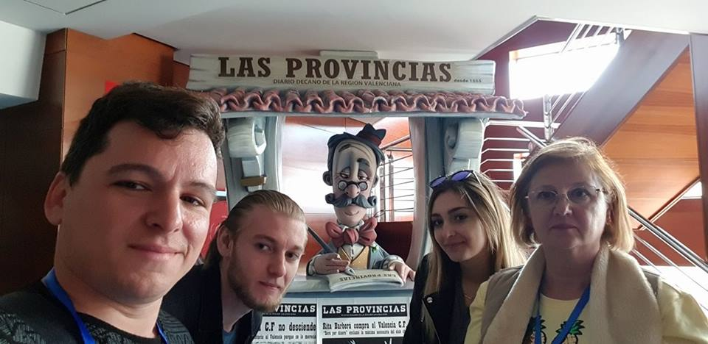
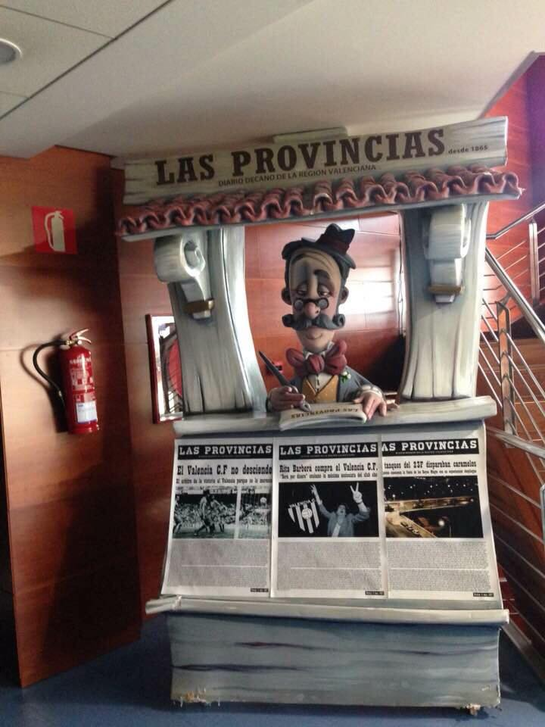
Fifth day:
19
04
2018
In the morning we go to school, where the first activity consisted of doing groups and drawing one of the lessons presented by students with the help of emoji, then we went to Las Provincias multimedia.At school Estonia present their lesson plan and after we played Italy and Greece games.

Slide 9
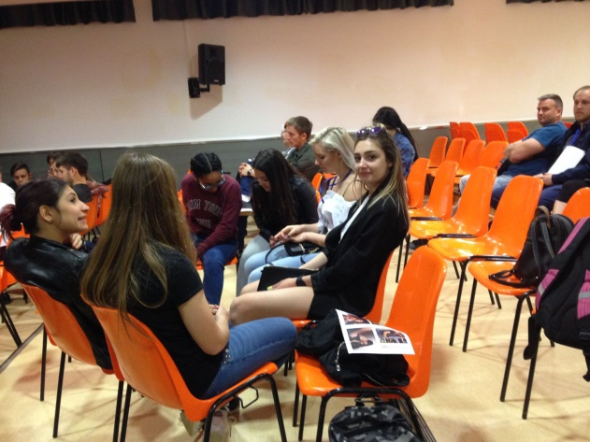
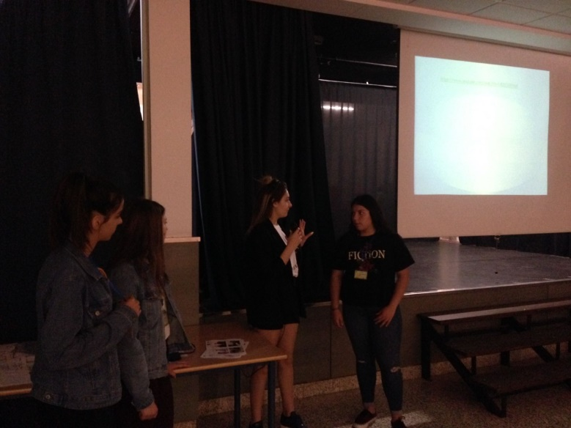

Slide 10
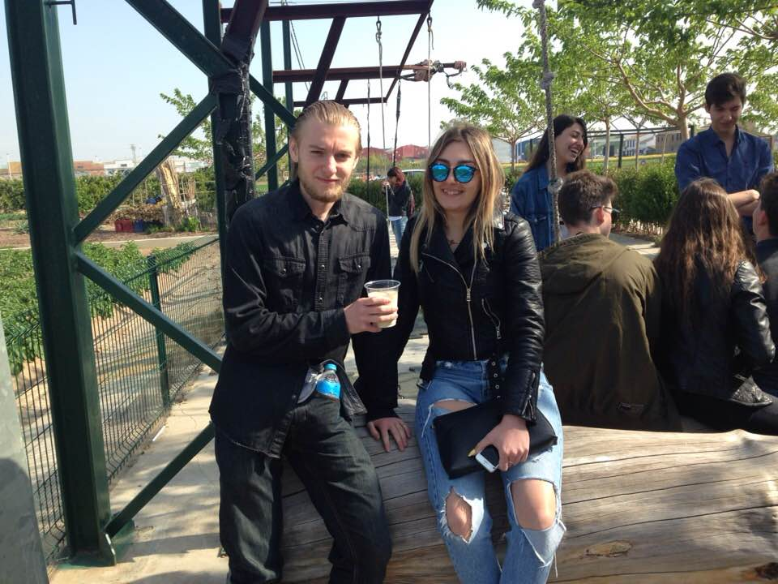
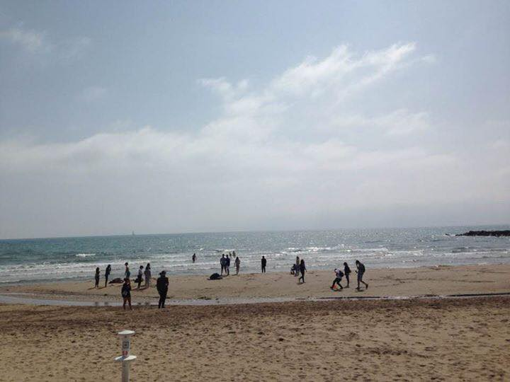
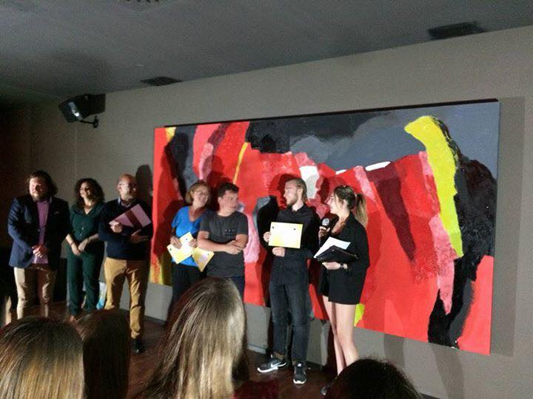
Sixth day:
20
04
2018
On the fifth day we finished the emoji projects, then we played our game and Turkey game.We go to Alboraia to see and taste Orxata, a specific beverage, then we were on the beach where we had to build a sand gadget in teams. Soon and the project ended in a wonderful way at the final party at the hotel.

Slide 11
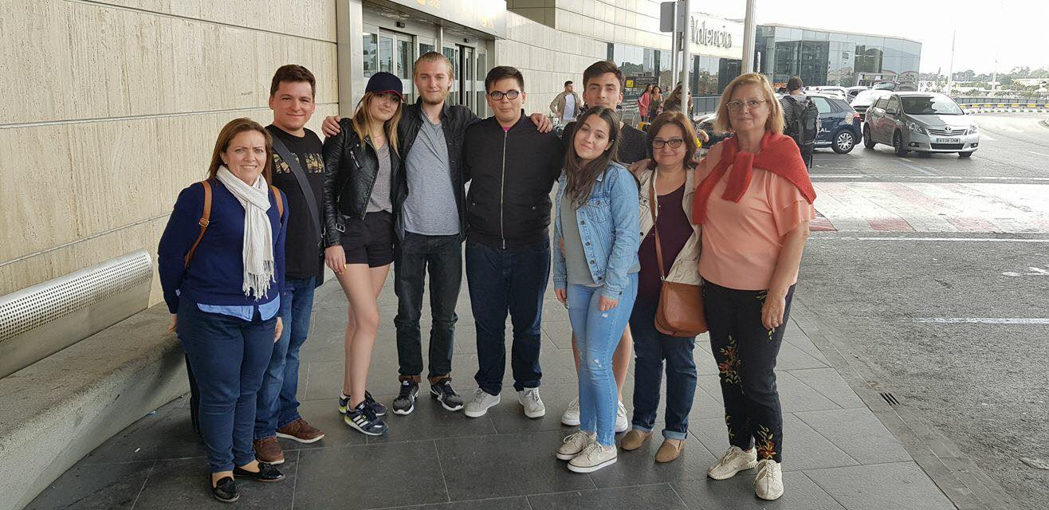
21
04
2018

