Slide 1
Understanding
and Critical Media Literacy
Newspapers analysis

Slide 2
The European Commission support for the production of this presentation does not constitute an endorsement of the contents which reflects the views only of the authors, and the Commission cannot be held responsi­ble for any use which may be made of the information contained therein.

Slide 3
We were working on the topic in September 2017.
The students were divided into three groups.
Then they presented their findings for the other classmates.
Group 1: FAKE NEWS
Group 2: BARCELONA TERROR ATTACKS
Group 3: BARCELONA TERROR ATTACKS

Slide 4
GROUP ONE – „Fake news“ about violence and unrest in Norway related to ISIS (analysing newspapers in Norway, Slovakia, Syria or Iraq)

Slide 5
2.Links for the website where we found the information
Norway https://www.aftenposten.no/norge (september) -we didn´t find any news
Syria
https://wn.com/syria_daily/news (september) -we didn´t find any news
Slovakia
http://www.svetkolemnas.info/novinky/zahranicni/5743-norska-policie- poplach-radikalni-islam
IN Slovakia- newspaper, we have seen the information about Oslo occupation.

Slide 6
3.who created this message?
According to us, the radical Islamists made this report.
This is the way how to make terror bigger.

Slide 7
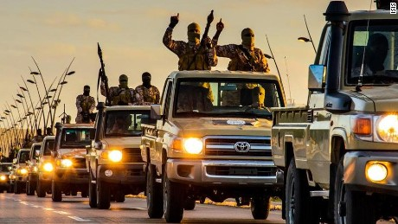
4.how might different people understand the same media message differently?
The European Union is unable to defend threat

Slide 8
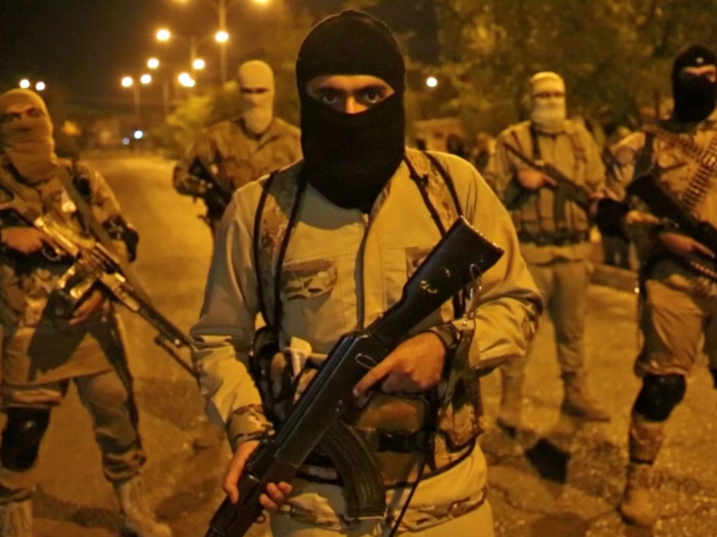
5.what is the main point in the news?
The police in Norway claims to have completely lost control of Oslo, as radical Islamists have taken over the area. (this was the message in the news online)

Slide 9
6.who gain profit and/or order?
ISIS gained profit from fake news and then they could be more known around the world

Slide 10
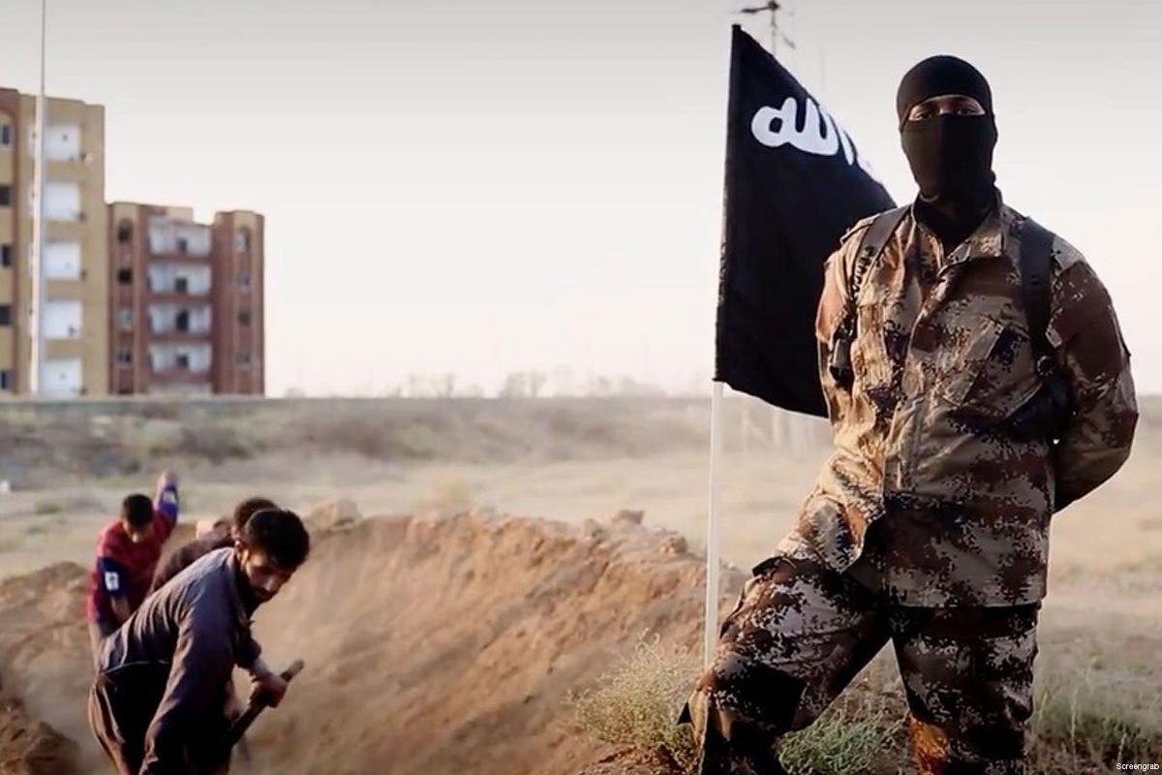
7.Interpretation
Our opinion of this situation is that evil prevailed in the world because terrorists are bombarding countries and killing people and children

Slide 11
8. Messages are constructed /awareness of the choices involved in the making of media messages sensitizes readers and viewers to the subtle shaping forces at work - in the choice of photography or cutline in a newspaper, in the images, pacing and editing in the news./
News are often misleading, so we should be careful when we read them

Slide 12
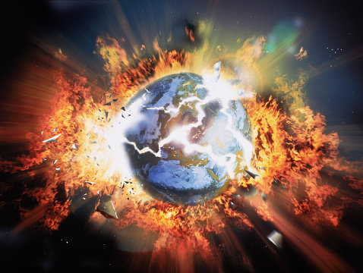
9.messages have economic and political purposes and contexts
Messages have probably political context , in purpose to influence the world.

Slide 13
GROUP TWO
„Barcelona terror attacks“

Slide 14
The incident occurred in the center near the shopping center on the busy Las Ramblas. Rescuers trying to help injured people on the ground have arrived on the site, informs the BBC. At least two people died, several were injured. The delivery driver is on the run.

Slide 15
The Spanish media reports that after the incident, two armed men entered the local restaurant, apparently holding back people.
The panic erupted in the street, threatening people looking for a shelter in the meantime of closed business operations.
Police evacuated the area and invited people to avoid the incident.

Slide 16
18:19 - The Reuters news agency reports that subway stations are closed.
18:20 - There are at least two people killed, about 20 people injured.
18:26 - Two armed men (apparently the driver and his accomplices) are detaining people in one of the Turkish restaurants, according to Spanish newspaper El Mundo.
18:28 - Police have called on the public not to post social events on the social networking sites.
18:31 - About 80 people are currently hiding in a local church near the incident.

Slide 17
18:54 - Local radio in Barcelona reports that at least 13 people died in the attack .Based on police resources.
18:46 - TV3 reports that six people died in the attack. A spokesman for a chain of ten restaurants said there were about 600 people hacking around in the business and waiting for the police to leave the scene.
18:40 - The attacker used a leased van.
18:38 - Spanish rescue services told the people of Catalonia's Barcelona area to stay in place.
18:58 - The police is looking for a second shipment to be the assailant.

Slide 18
19:32 - According to the Catalan channel TV3, the police have already found the second vehicle they were searching for.
19:25 - A police investigator told a press conference that the death of one person was confirmed. Another 32 people are injured, of which ten are
19:11 - Eyewitness Lourdes Porcar told TV3 that he saw a van that coaxed people.

Slide 19
20:10 - According to the Spanish media, the driver deliberately turned the vehicle to hit as many people as possible.
20:04 - Police detained the first suspect, informs Spanish public-law media RTVE.
20:02 - None of the Slovaks in Barcelona has yet to suffer injury , informs the Ministry of Foreign Affairs and European Affairs of the Slovak Republic.
19:54 - "We can never rule out the killing of individuals, but they are always fighting together better and more effectively against similar threats.
19:45 - Barcelona's TV3 says a Spanish passport of a person of Moroccan origin was found on the scene.
19:40 - The Spanish media published a photograph of a man who rented a van that hit the crowd. El País also mentioned his alleged name: Driss Oukabir.

Slide 20
20:56 - Slovak President Andrej Kiska has expressed his condolences to the families.
20:46 - One of the attackers died during a police shootout.
20:42 - Facebook has activated its security control mechanism, which lets people know their relatives are okay.
20:25 - Catalan Interior Minister Joaquim Forn officially confirmed that 13 people died during the attack and another 50 were injured.

Slide 21
21:47 - Police Force for the Spanish Region of Catalonia confirmed the second incident in which he shot the suspect.
21:26 - According to Catalan Prime Minister Carliso Puigdemont, the police detained the attack after two people attacked.
21:09 - "It's an attack on democracy and freedom," Carles Puigdemont said.
22:11 - The streets near the attack site are closed, the metro or the train does not work.
22:00 - Terrorist group Islamic State accused of responsibility for today's attack. She said through her Amak press agency.

Slide 22
https://www.aktuality.sk/clanok/514026/do-davu-ludi-v-barcelone-vrazil-vodic-s-dodavkou/
Attacker run over people.
Guy from Morocco has attacked the crowd of people and he killed 13 people,80 people are injured.
It has political purposes.

Slide 23
GROUP THREE
„Barcelona terror attacks“
In 3 different views

Slide 24
1. Who created this message?
Spain news : Marocco news : Slovakia news :
EFE Spain Marocco World News tvnoviny.sk
https://www.efe.com/efe/english/patrocinada/a-timeline-of-the-terror-attacks-in-barcelona-and-cambrils-spain/50000268-3355417
18. August 2017
https://www.moroccoworldnews.com/2017/08/226368/13-dead-many-injured-terrorist-attack-barcelona/
17. August 2017
http://www.tvnoviny.sk/zahranicne/1882778_prve-zname-obete-utoku-v-barcelone-otec-z-talianska-drzal-syna-za-ruku-potom-zomrel

Slide 25
2. How might different people understand the same media message differently?
Spain news : Marocco news: Slovakia news:
I think everyone trusts
this news because
it was everywhere in
social media Tv´s etc…
I think everyone trusts this news because it was everywhere in social media in the world .
I think it is really trustfull.

Slide 26
3. What is the main point in the news?
Spain news : Marocco news : Slovakia news :
The two consecutive terror attacks in the northeastern Spanish region of Catalonia have left 19 people dead, including five suspected attackers, and more than 100 injured.
Rabat – At least thirteen were left dead and several injured in an alleged terrorist attack in Barcelona this Thursday evening, as a van plowed into a crowd of people near the popular tourist area of Las Ramblas. Catalan authorities have said that two armed men left the crash scene and entered a restaurant, with the sound of gunfire reported
The first known victims of the attack in Barcelona

Slide 27
4. Who gain profit and / or order?
Spain news : Marocco news : Slovakia news:
I think the terrorists want to be known and they are preparing something bigger.
In my opinion they warn us against a possible greater threat
I think that their radicalism tells them what to do and they think that it is the right thing

Slide 28
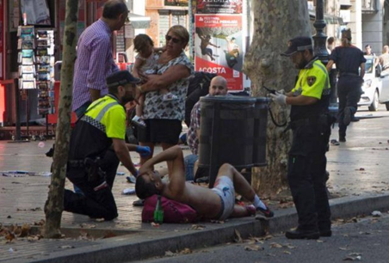
5. Interpretation
Spain news : Morocco news : Slovakia news :
I think they are warning before danger and they inform people how much they are injured and dead
In my opinion this article is very well written it contains all information that happened in Barcelona.

Slide 29
6. Messages are constructed /awareness of the choices involved in the making of media messages sensitizes readers and viewers to the subtle shaping forces at work - in the choice of pohotography or cutline in a newspaper, in the images, pacing and editing in the news./
Spain news : Morocco news : Slovakia news :
Images aren´t so important in this article. This article is aiming to the text written in it.
I think the pictures in the article are less important than the content itself.
In one picture there is a family depicted

Slide 30
7. Messages have economic and political purposes and contexts.
Spain news : Morocco news : Slovakia news :
An article is written in time sequence and it is for people to inform them what really happened in Barcelona.
This article is more of a political significance
One man put a photo of his family on a social network and a dead wife who died in a terrorist attack

Slide 31
PHOTOS

Slide 32
