Slide 1
UNDERSTANDING AND CRITICAL MEDIA LITERACY
UNDERSTANDING AND CRITICAL MEDIA LITERACY

Slide 2
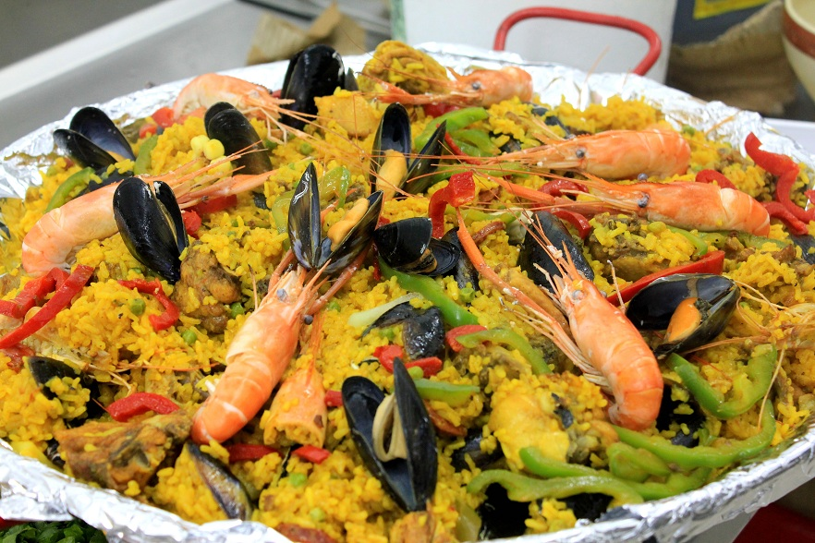
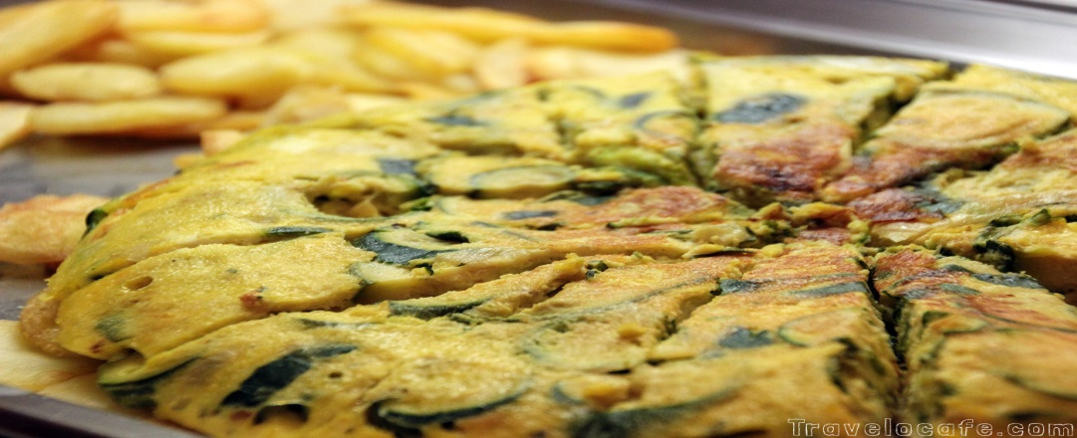
So i ve spent wonderful times with my family Blanco and I wish to visit them again.I ve experienced due to them spanish traditional food In this family there are two parents with two sons who are living in a small and beautiful house

Slide 3
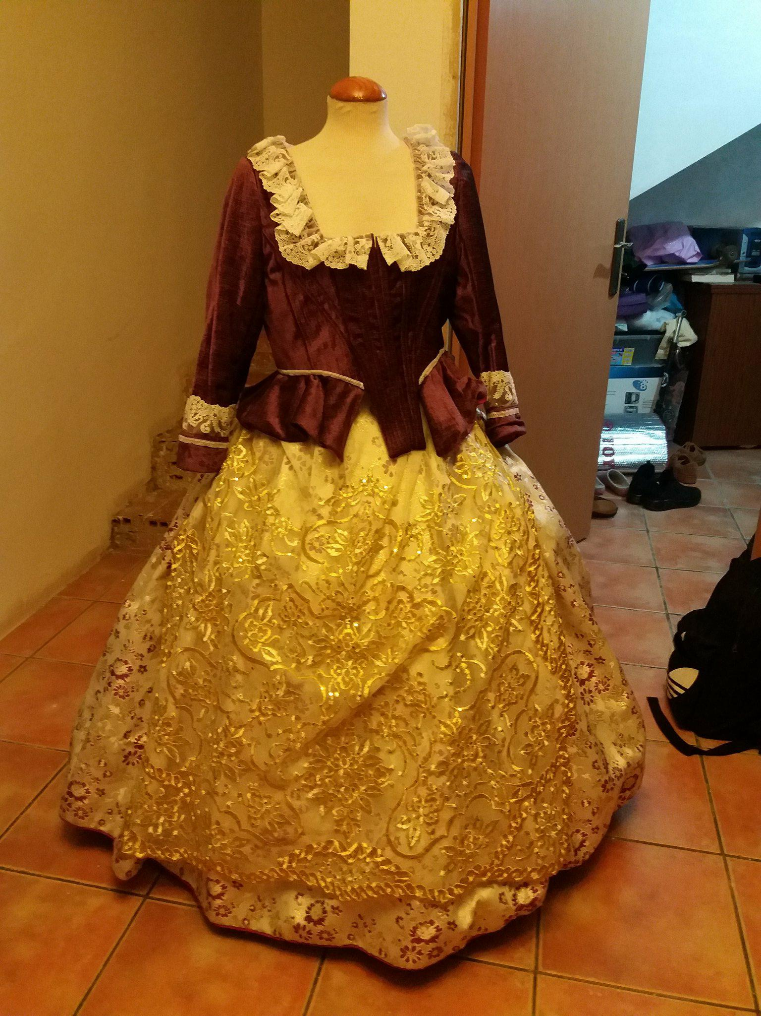
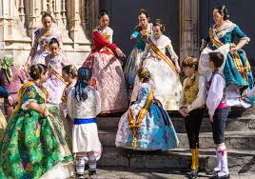
The mother of the two sons is very talented at creating traditional and spectacular dresses for the anual festival of their town Paterna.This festival is organising every year on March and it is said the whole community is participating as much as they can.You can see in the picture an amazing dress which is very complicated to create.

Slide 4
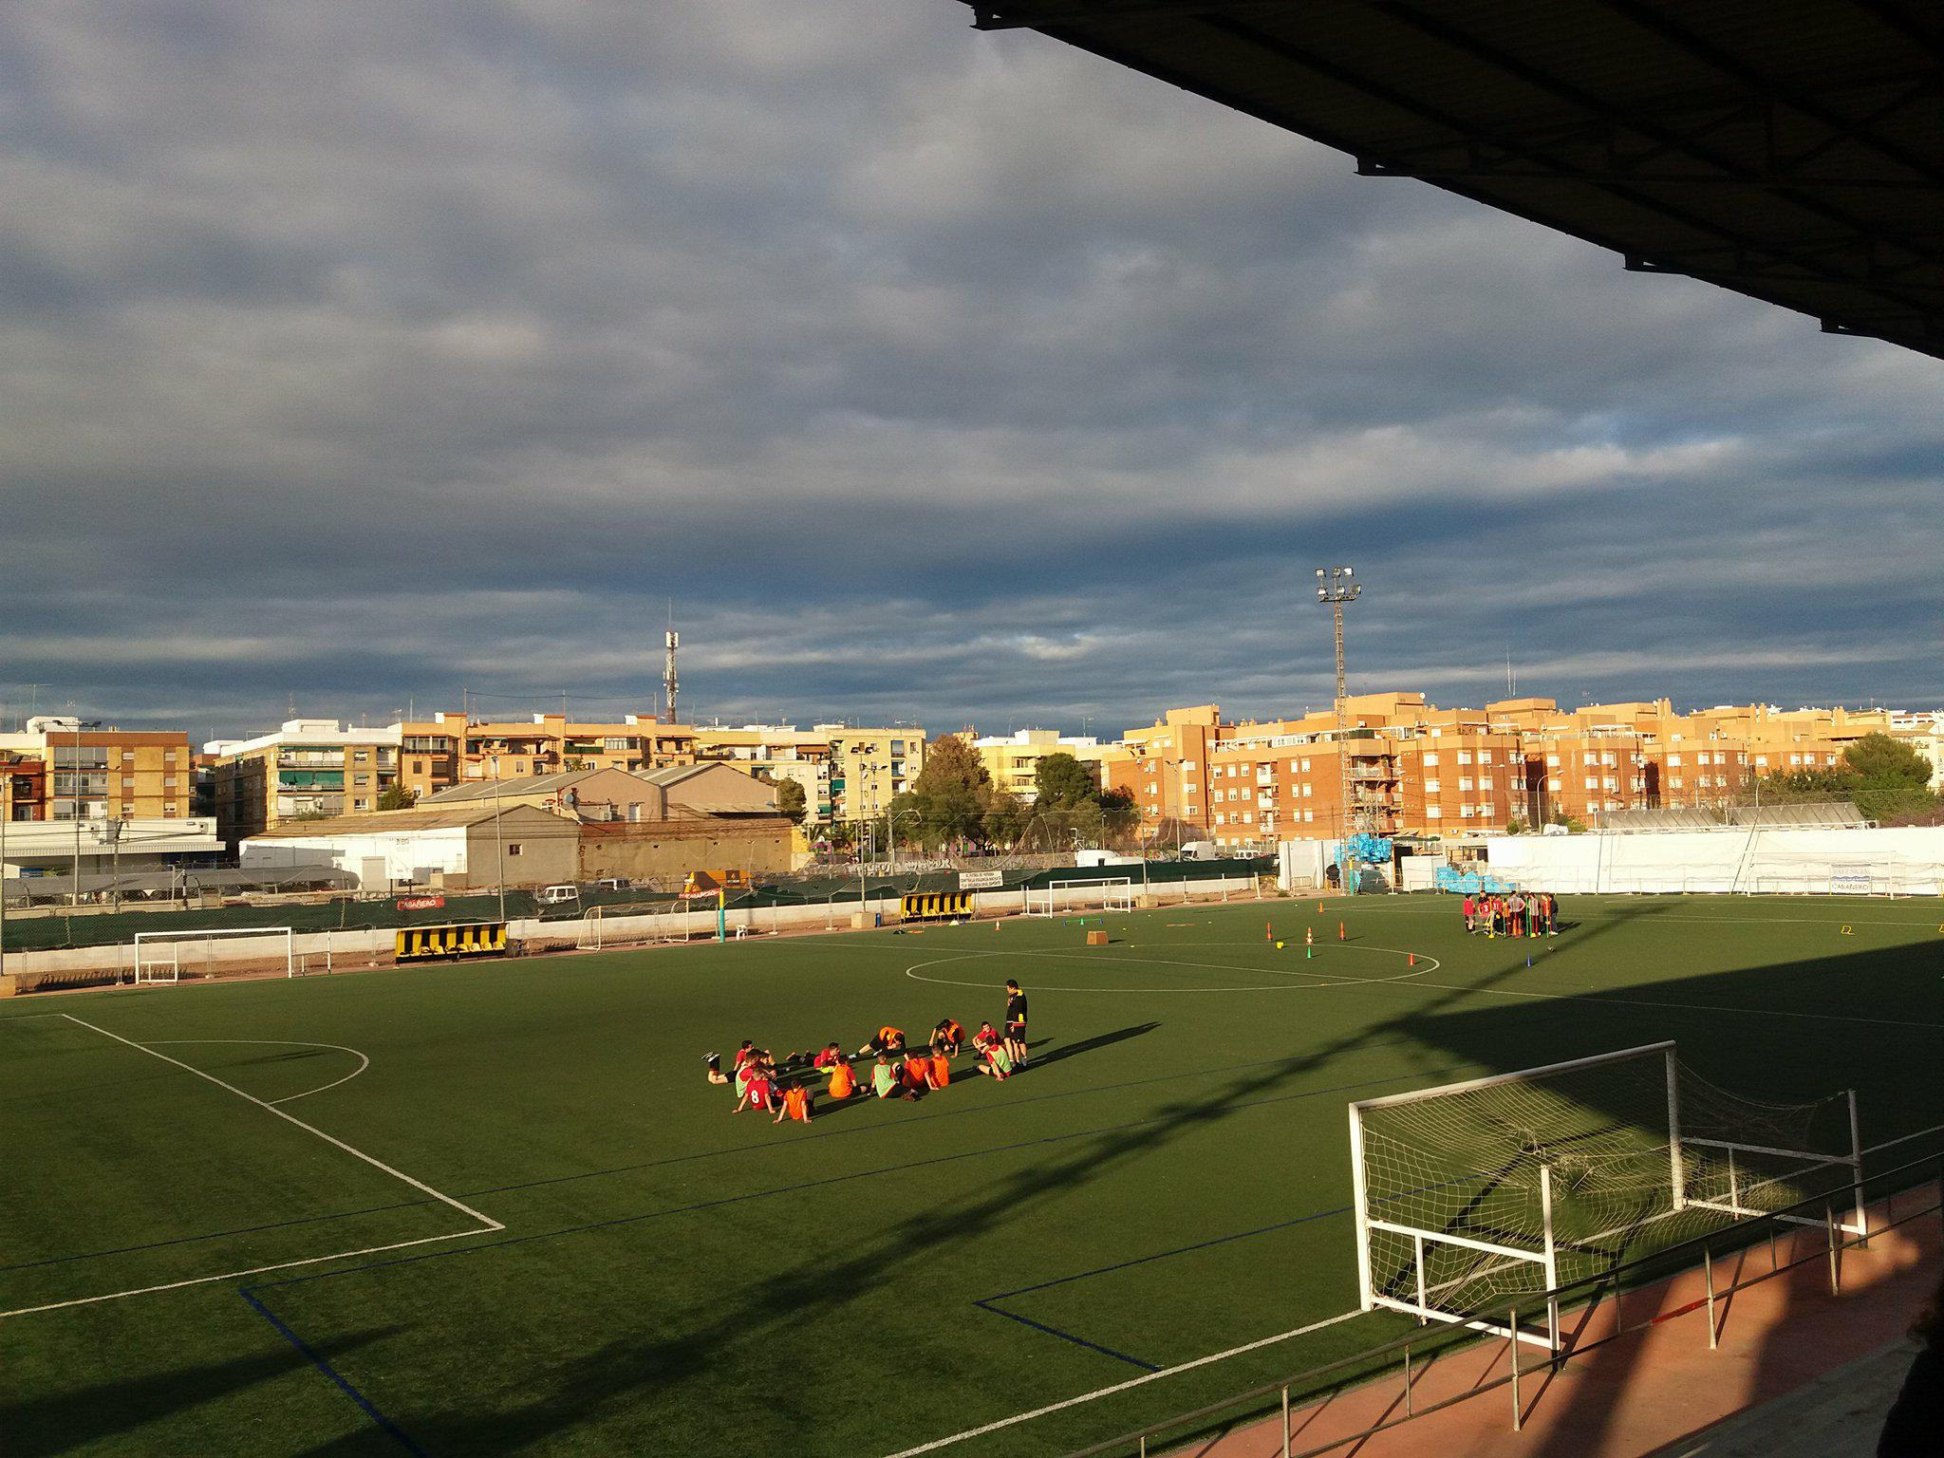
One of the son Alejandro who guided me there at the school is talented too: he's playing football since he was a kid and he took me to the training football at the stadium.He is making part of the football team of his town.

Slide 5
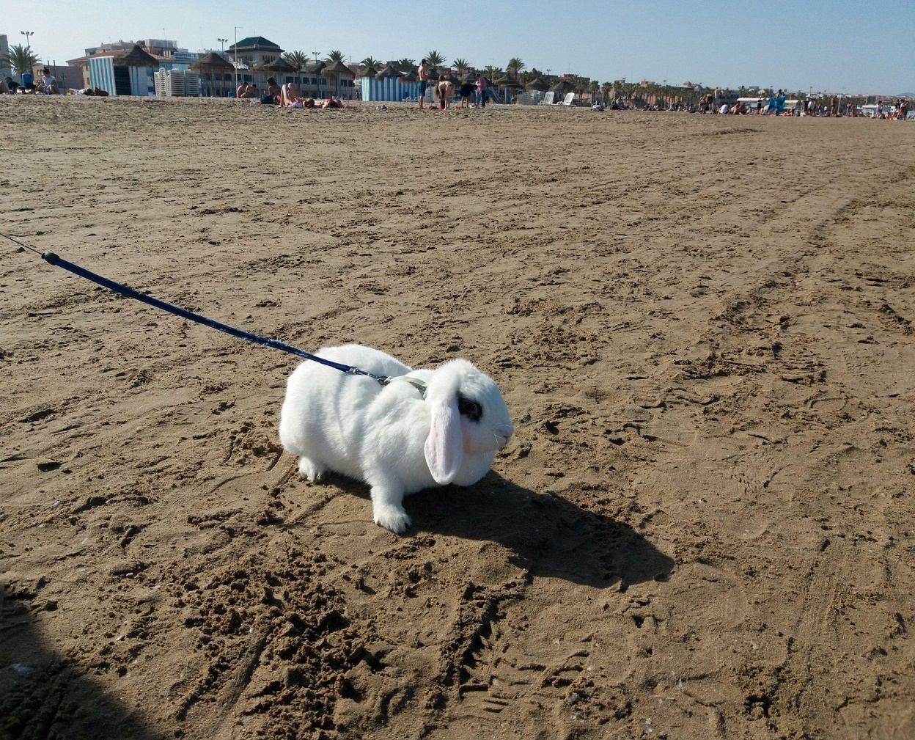
My family from spain took me to the beach which is beautiful and interesting
The sea has a particular blue colour with little waves and I noticed that there were many tourists there.
I stayed with my family in the beach for like 2 hours and we walked and we touch the cold water with our feet
A funny story is that we met a man with a rabbit walking on the beach and he let me to make a photo with the rabbit: the rabbit is big and white and he has a long chain in order to not run

Slide 6
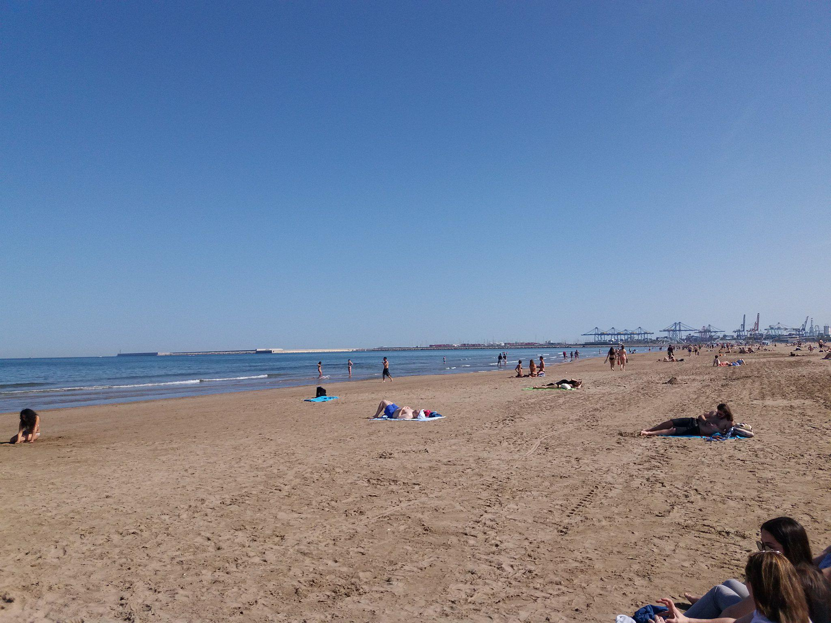

Slide 7
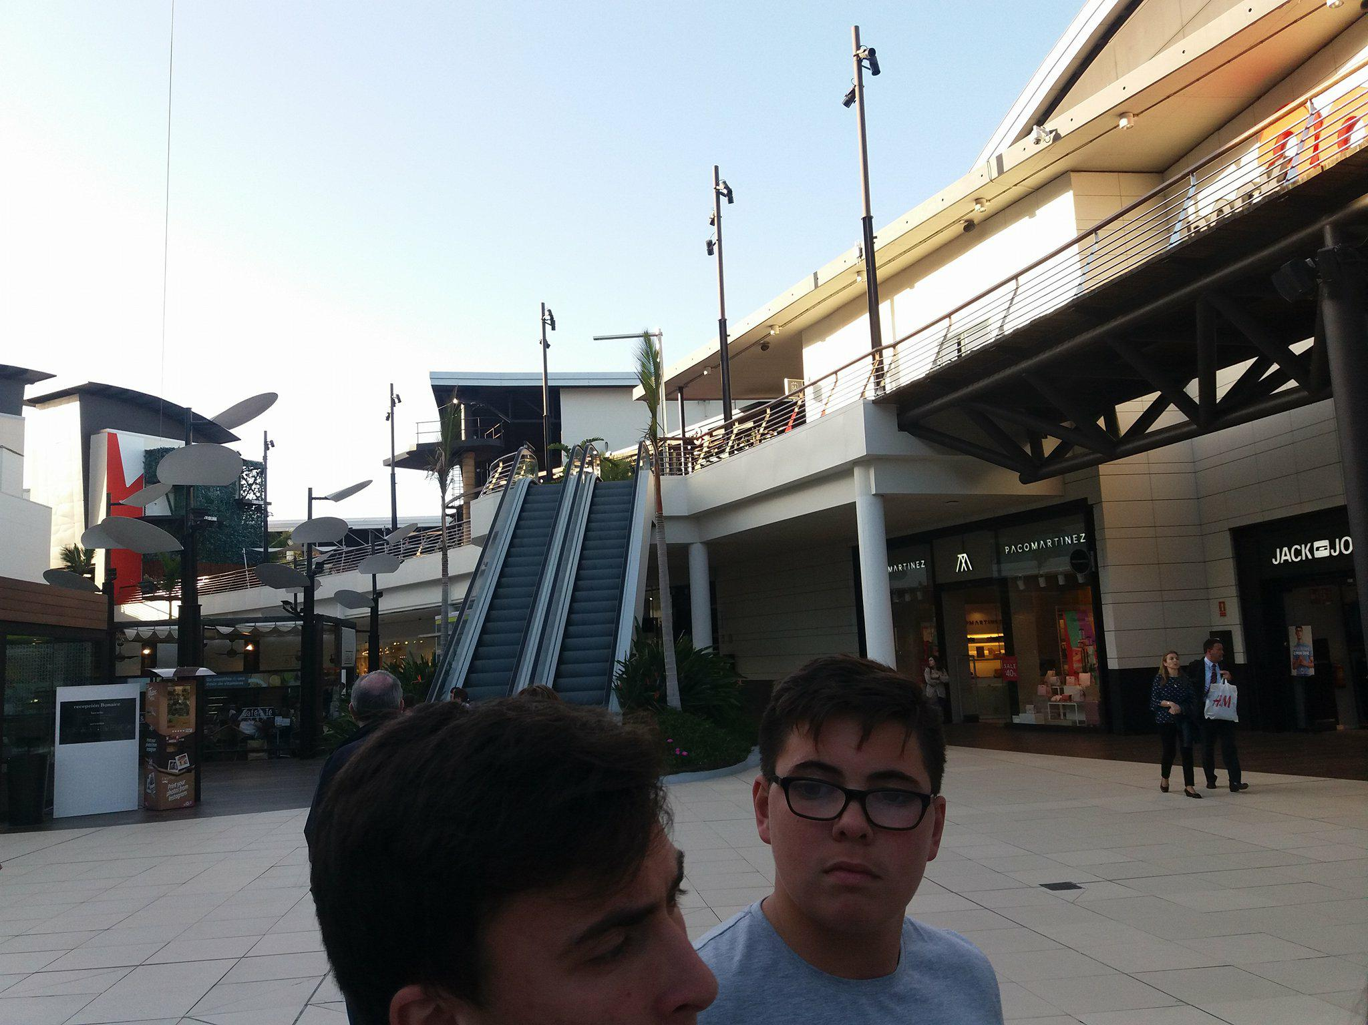
Because the family Blanco wanted to see the surroundings from Paterna and they knew that l have to make some shopping they took me to the mall. I didn t see that kind of mall before and it room me by surprise.The mall ls huge enough to lose there and it has all kind of shops, such as anime store.

Slide 8
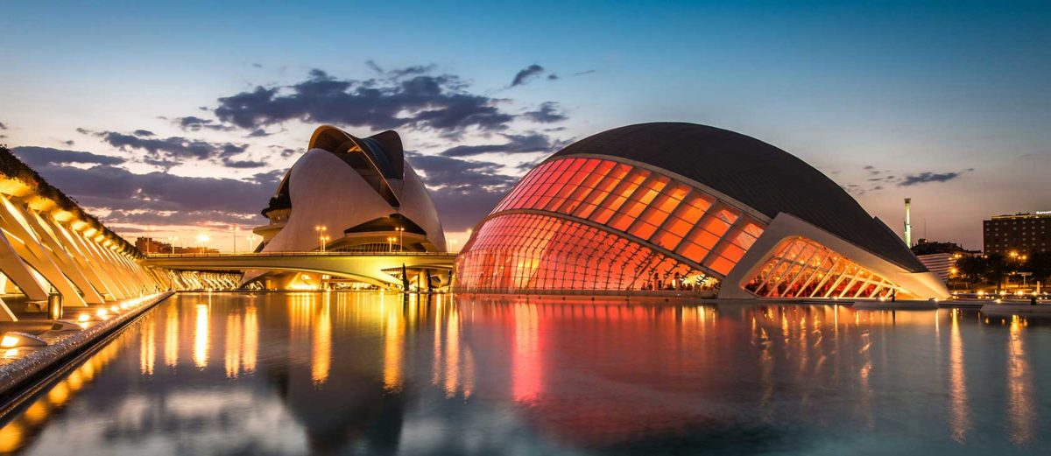
To sum up, my experience in Spain was speechlless, extraordinary and unforgettable.I stayed at a beautiful and lovely family in Paterna and I hope to visit them soon.

